Slide 1
ClimbCode
Notes:
Welcome to ClimbCode’s exposition. Here we’ll see the main features of this project.

Slide 2

Our Path Today
Idea
The Workgroup
MVP & Business
Technologies
Status
2
Notes:
The main points we’re going to talk about are the following ones: First, we’ll introduce the team which will develop the project. Next, we’ll talk about the idea that ClimCode represents and which are the features that form the Minimum Viable Product. Then, we’ll skip to the business environment and the costs of the project, followed by the ways that we will have in order to achieve profit with it. Finally, we’ll speak about the work methodology that will be followed in the development of the project, and the technologies that we will use on it.

Slide 3
Idea
Notes:
Now we’ll talk about the main idea of ClimbCode, and its principal features.

Slide 4
Learn Programming?
4
Notes:
But the fact of using programming to create those exercises makes a great doubt appear: Is it necessary to learn programming to use this plataform as a school?

Slide 5
Learn Programming?
5
Notes:
But the fact of using programming to create those exercises makes a great doubt appear: Is it necessary to learn programming to use this plataform as a school?

Slide 6


Idea
+
=
ClimbCode
6
Notes:
ClimbCode is the result of a fusion between teaching and programming. This fusion is, in fact, a plataform used to support the teaching of different subjects at high schools and academies. This support is given as interactive exercises made by programmers which use programming in order to teach other concepts from other different subjects.

Slide 7


Idea
=
+
Interactive
7
Notes:
This exercises are nothing but a combination of the usual exercises from other subjects and coding, which results into a new brand kind of exercises which form the principal content of our platform. These exercises are an alternative to the usuales ones instead of a way to learn programming, fulfilling the objectives of the usual ones in a new and interesting way.

Slide 8
The Workgroup
Notes:
First, let’s introduce our team members.

Slide 9
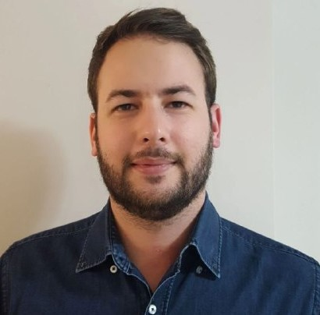

The Workgroup
Alejandro Román Rodríguez
Project Manager
Álvaro Domínguez Núñez Business Manager
9
Notes:
Alejandro Román, who is the Project Manager, Álvaro Domínguez, the Business Manager…

Slide 10
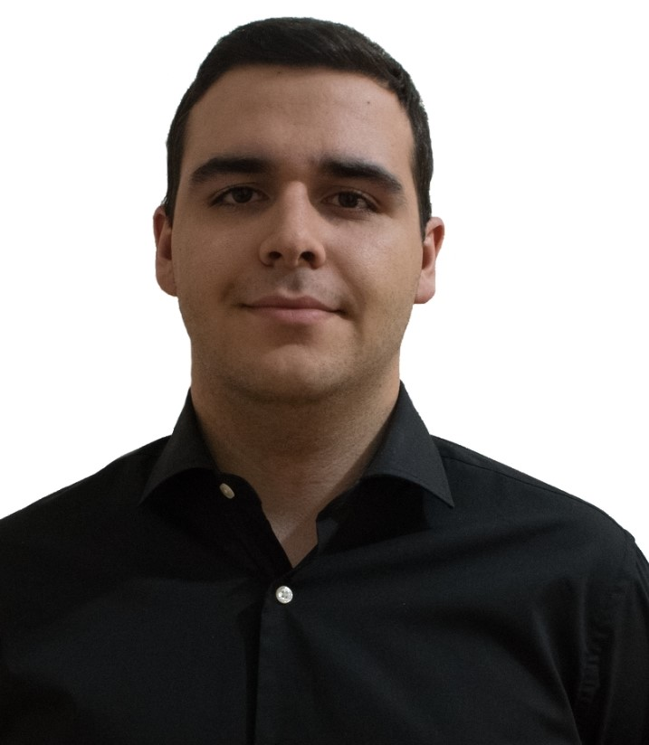
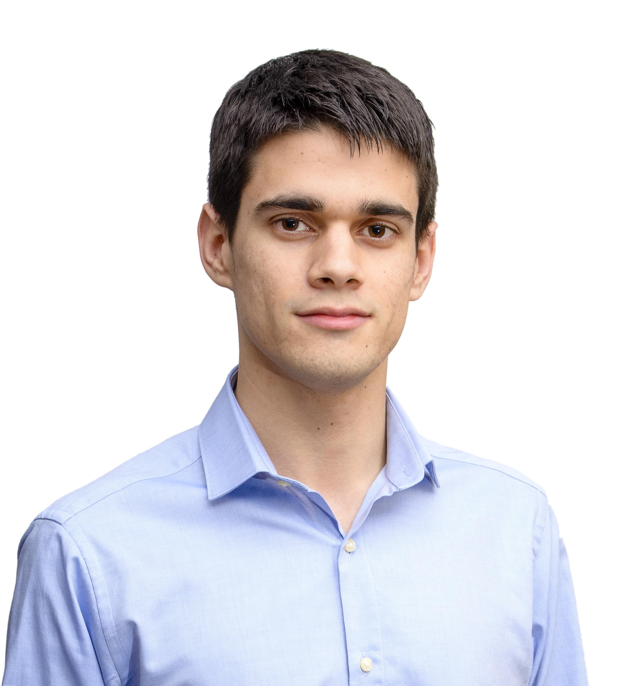
The Workgroup
Andrés Fernández Alés
Software Engineer
Alejandro Garrido Resina
Software Engineer
10
Notes:
And the software Engineers: Andrés Fernández, Alejandro Garrido…

Slide 11
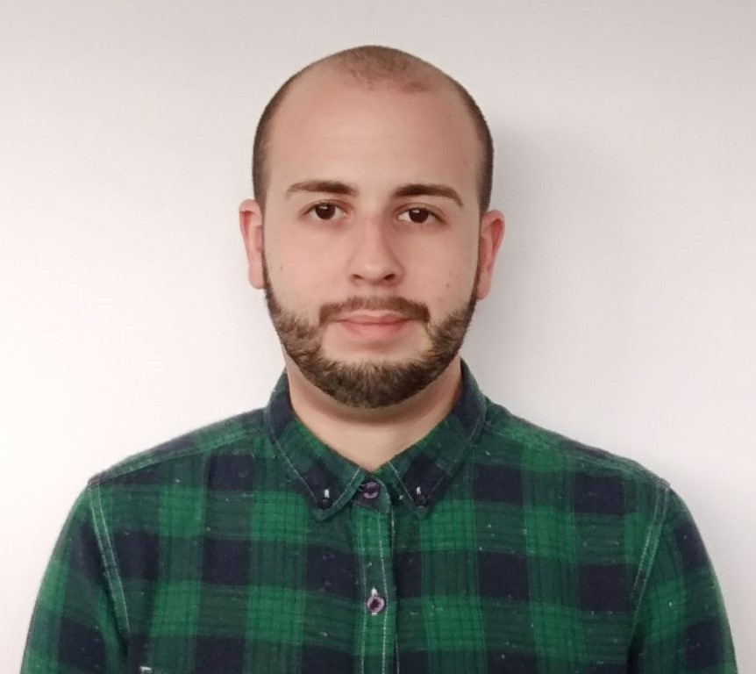
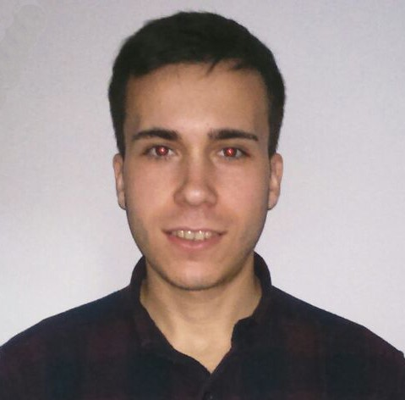
The Workgroup
Miguel Ángel Baños Carretón Software Engineer
Álvaro Sánchez López
Software Engineer
11
Notes:
Miguel Ángel Baños, Álvaro Sánchez…

Slide 12
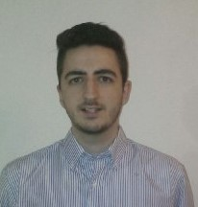
The Workgroup
Jesús Sosa Sánchez
Software Engineer
12
Notes:
And Jesús Sosa. These are our seven members.

Slide 13
MVP & Business
Notes:
Now we’ll talk about the main idea of ClimbCode, and its principal features.

Slide 14

Learn Programming?
14
Notes:
But the fact of using programming to create those exercises makes a great doubt appear: Is it necessary to learn programming to use this plataform as a school?

Slide 15

Learn Programming?
15
Notes:
The answer is absolutely not! And that’s because the exercises, despite being created by those means, are interactive and both teachers and students can make use of them without any programming knowledge.

Slide 16

MVP & Business
Interactive
16
Notes:
That’s when the schools and academies come to scene. They buy those exercises from the programmer in order to increase the amount of exercises they have and offer their teachers a higher volume of content to use in their lessons.

Slide 17

MVP & Business
Student & Teacher:
Interactive
17
Notes:
Once the school acquires the new exercises, teachers can use then to support their lessons, and students can access them in order to do them and use them as an addition to their learning. As another feature, teachers will be able to upload and download documents related to their subjects into the platform, and students can also access it.

Slide 18
MVP & Business
Subjects covered:
18
Notes:
Once the school acquires the new exercises, teachers can use then to support their lessons, and students can access them in order to do them and use them as an addition to their learning. As another feature, teachers will be able to upload and download documents related to their subjects into the platform, and students can also access it.

Slide 19

MVP & Business
Administrator:
19
Notes:
And last, but not least, the administrators of the system will be able to register new schools. These schools would be able to manage their teachers and students.

Slide 20
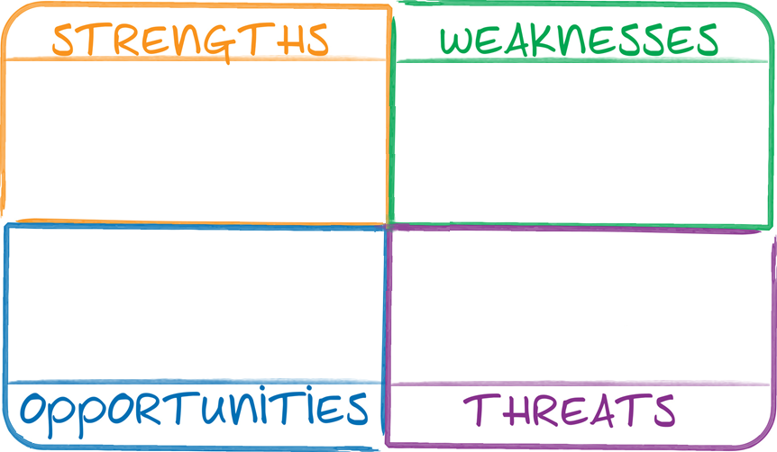







20
Notes:
And last, the theats that our project has to face are two: The fact that our competitors could take our idea and use it on their products, making competence harder for us, and the possibility that we can understimate the difficulty of developing some of our features, which could result into a delay in its development.

Slide 21

How much?
21
Notes:
Once we’ve seen the acceptance of our product, the next doubt that we can have in mind is how much would that project cost in practice.

Slide 22
MVP & Business
Direct Costs: €16K
(Salaries)
Indirect Costs: €4,75K
(Co-working, hosting)
Marketing: €4K
22
Notes:
Then, we can see that, in the 4 months that the project would develop, we have an amount of 16000€ in direct costs, which refer to our team’s salaries.
In the case of the indirect costs, we would have 4750€ spent into co-working spaces, hosting of the application and amortizations.
Finally, about the marketing of the product, we would spent 4150€

Slide 23
MVP & Business
€25K + €4K = €29K
23
Notes:
All those costs would make a total of 24900€. Adding the 4150€ saved for risks by the team, the project would cost a total of 29050€.

Slide 24
Is it profitable?
24
Notes:
Seen that data, how do we get profit from the project and recover that investment?

Slide 25

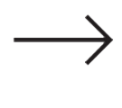
MVP & Business
Schools buy licenses
25
Notes:
The first way to do so would be selling licenses to schools. These licenses would be active for a year and would allow the schools and academies to make use of the full platform for an entire academic year, renewing it each one to keep the services. Also with the license, schools and academies would have access to an amount of starting exercises that can be increased by buying more exercises.

Slide 26
MVP & Business
Interactive
Schools buy exercises
26
Notes:
The second way we have for having a profit with these project is selling exercises. Interactive exercises have a buying price, which is payed for the schools and academies in order to increase the amount of exercises they have access to.

Slide 27

MVP & Business
%
ClimbCode
%
Programmer gets money
27
Notes:
From this price, a percentage goes to the programmer, acting as a motivation for possible content creators for the platform, and another percentage is kept for us.

Slide 28

MVP & Business
28
Notes:
As a clarification, all the previous transactions mentioned are made through PayPal, whose features will be integrated in our platform.

Slide 29
MVP & Business
29
Notes:
As a clarification, all the previous transactions mentioned are made through PayPal, whose features will be integrated in our platform.

Slide 30
Technology
Notes:
Finally, we’ll talk about the work methodology that we’re going to follow in this project.

Slide 31




Technology
Development:
31
Notes:
About the technologies we’re going to use, related to development we will use Pyhton, Django and PostgreSQL for the main part of the product, and JavaScript for the interactive excercise management. The team isn’t an expert in these technologies, but has enough experience to face the development of the project with them.

Slide 32

Technology
Knowledge:
32
Notes:
Regarding the knowledge management, we will make use of a git repository hosted in github, where we can follow the development of the project and its tasks, adding the documentation and the knowledge generated if needed.

Slide 33
Technology
33
Notes:
Regarding the knowledge management, we will make use of a git repository hosted in github, where we can follow the development of the project and its tasks, adding the documentation and the knowledge generated if needed.

Slide 34
Status
Notes:
Finally, we’ll talk about the work methodology that we’re going to follow in this project.

Slide 35
Status
0%
50%
100%
€4,7K
€29K
211 h
1120 h
Current: €16%, 19% h
Budgeted: €18%, 19% h
35
Notes:
At the moment, we’ve spent the 16% of the money we’ve estimated (4688€), which puts us below the money expected to spent during these weeks.

Slide 36
Status
0%
50%
100%
€14,5K
560 h
€29K
1120 h
Best: 50%
36
Expected: 100%
Notes:
In the best of the cases, we expect to spend half the amount budgeted both in terms of hours and money.

Slide 37
Status
0%
100%
200%
€29K
1120 h
€58K
2240h
Expected: 100%
37
Worst: 200%
Notes:
In the worst of the cases, on the other hand, we expect to spend twice the amount budgeted both in terms of hours and money.

Slide 38

Status
Sprint 1:
Interactive
38
Notes:
As we know, we’ll use in the subject SCRUM as a methodology for developing the project, with 3 sprints to do so. The first one we will focus on developing the main CRUD of the system, with the first iteration over the interactive exercises’ system, whose objective in this sprint will be creating and doing exercises, but not saving them. As a result, we would have a basic platform in which we can create and manage schools and subjects as an administrator, create users (teachers and students) and select the exercises we want in our license as a school, create exercises as a programmer, do exercises as a student, and have a group of initial interactive exercises ready to persist.

Slide 39
Status
39
Notes:
As we know, we’ll use in the subject SCRUM as a methodology for developing the project, with 3 sprints to do so. The first one we will focus on developing the main CRUD of the system, with the first iteration over the interactive exercises’ system, whose objective in this sprint will be creating and doing exercises, but not saving them. As a result, we would have a basic platform in which we can create and manage schools and subjects as an administrator, create users (teachers and students) and select the exercises we want in our license as a school, create exercises as a programmer, do exercises as a student, and have a group of initial interactive exercises ready to persist.

Slide 40
Status
40
Notes:
As we know, we’ll use in the subject SCRUM as a methodology for developing the project, with 3 sprints to do so. The first one we will focus on developing the main CRUD of the system, with the first iteration over the interactive exercises’ system, whose objective in this sprint will be creating and doing exercises, but not saving them. As a result, we would have a basic platform in which we can create and manage schools and subjects as an administrator, create users (teachers and students) and select the exercises we want in our license as a school, create exercises as a programmer, do exercises as a student, and have a group of initial interactive exercises ready to persist.

Slide 41
Status
Alejandro Román Rodríguez
Project Manager
Álvaro Domínguez Núñez Business Manager
41
Notes:
Alejandro Román, who is the Project Manager, Álvaro Domínguez, the Business Manager…

Slide 42
Status
Andrés Fernández Alés
Software Engineer
Alejandro Garrido Resina
Software Engineer
42
Notes:
And the software Engineers: Andrés Fernández, Alejandro Garrido…

Slide 43
Status
Miguel Ángel Baños Carretón Software Engineer
Álvaro Sánchez López
Software Engineer
43
Notes:
Miguel Ángel Baños, Álvaro Sánchez…

Slide 44
Status
Jesús Sosa Sánchez
Software Engineer
44
Notes:
And Jesús Sosa. These are our seven members.

Slide 45

Status
Future Sprints:
Interactive
45
Notes:
So, the next sprints would be focused on saving the interactive exercises, promoting them, doing the document management section, managing the transactions in the platform, fixing the feedback we get, and developing filters and searching ways for the interactive exercises’ list

Slide 46
Status
Future Sprints:
Interactive
46
Notes:
So, the next sprints would be focused on saving the interactive exercises, promoting them, doing the document management section, managing the transactions in the platform, fixing the feedback we get, and developing filters and searching ways for the interactive exercises’ list

Slide 47

THANKS!
You can find me at
alvdomnun@alum.us.es
47
Notes:
And that’s the end of our presentation! Thank you for watching, and if you have any doubt you can contact me at alvdomnun@alum.us.es.

